Slide 1
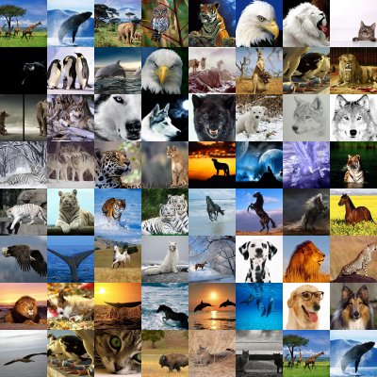
THE ANIMALS LOS ANIMALES NATALY GONZÁLEZ ZAPATA 9°2 #14

Slide 2
GATO
CAT
GOAT
DOG

Slide 3
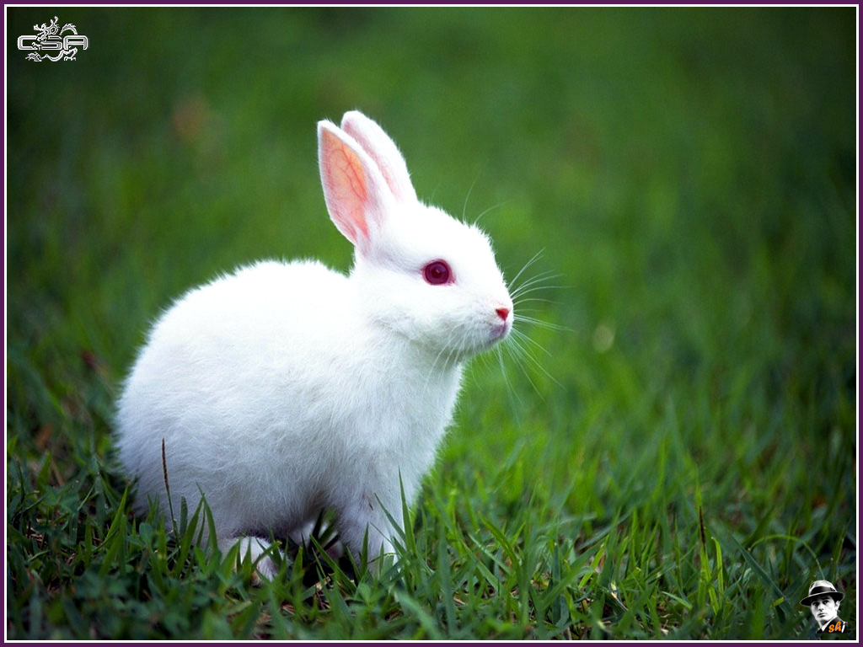
CONEJO
DOG
PINK
RABBIT

Slide 4
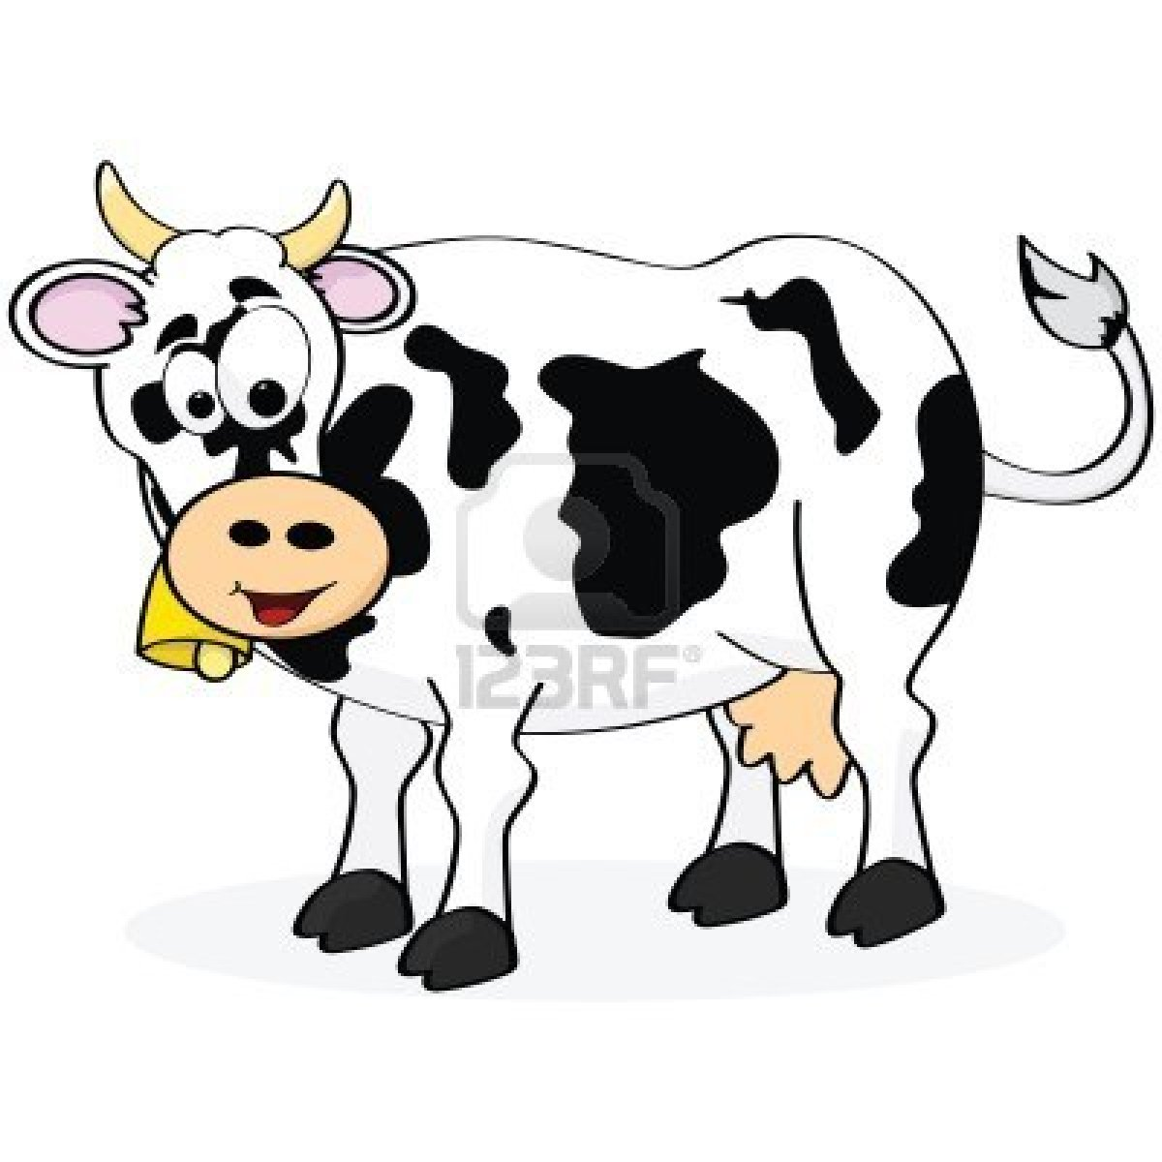
VACA
COW
BEE
MONKEY

Slide 5
TIGRE
DOG
LION
TIGER

Slide 6
LEÓN
ZEBRA
LION
DOG

Slide 7
COCODRILO
INSECT
ZEBRA
CROCODILE

Slide 8
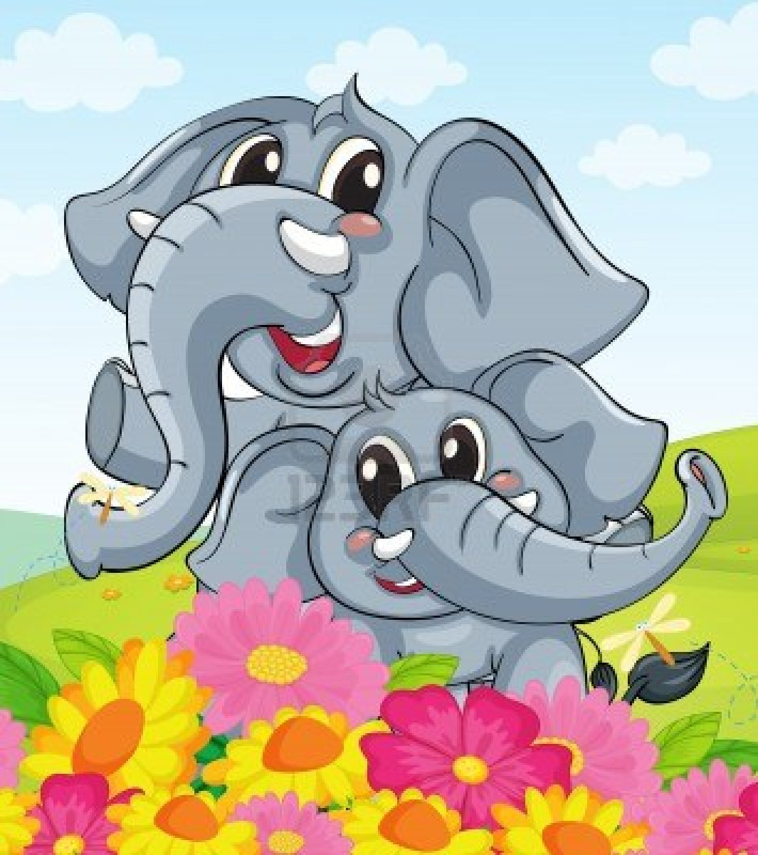
ELEFANTE
CAT
PINK
ELEPHANT

Slide 9
HIPOPÓTAMO
DONKEY
MONKEY
HIPPOPOTAMUS

Slide 10
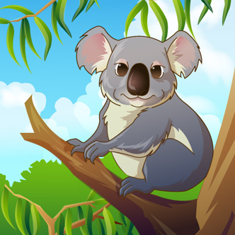
COALA
MONKEY
ZEBRA
KOALA

Slide 11
POLLITO
CHICK
HORSE
MONKEY

Slide 12
EXCELLENT
1 | 2 | 3 | 4 | 5 | 6 | 7 | 8 | 9 | 10

Slide 13
FAILED
1 | 2 | 3 | 4 | 5 | 6 | 7 | 8 | 9 | 10

