Slide 1
Vocabulario Básico de Ingles
Leidy Patiño Ortiz
9°1

Slide 2
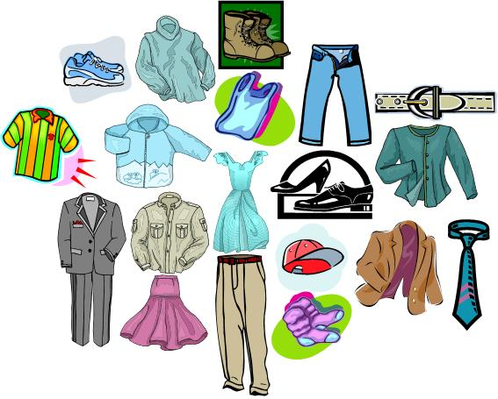

Slide 3

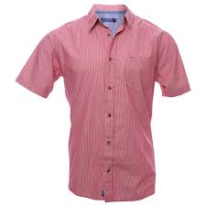
Camisa
T-shirt
Shirt
Coat

Slide 4


Slide 5


1 | 2 | 3 | 4 | 5 | 6 | 7 | 8 | 9 | 10 | 11 | 12 | 13 | 14 | 15 | 16 | 17

Slide 6

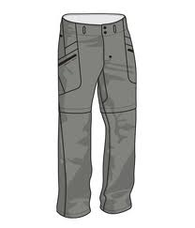
Pantalón
Pants
skirt
Shorts

Slide 7

Fallaste

Slide 8
1 | 2 | 3 | 4 | 5 | 6 | 7 | 8 | 9 | 10 | 11 | 12 | 13 | 14 | 15 | 16 | 17

Slide 9

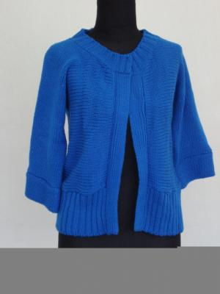
Saco
Shirt
Coat
Vest

Slide 10
Fallaste

Slide 11
1 | 2 | 3 | 4 | 5 | 6 | 7 | 8 | 9 | 10 | 11 | 12 | 13 | 14 | 15 | 16 | 17

Slide 12

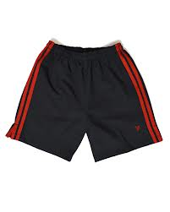
Pantaloneta
Shorts
Pants
Underpants

Slide 13
Fallaste

Slide 14
1 | 2 | 3 | 4 | 5 | 6 | 7 | 8 | 9 | 10 | 11 | 12 | 13 | 14 | 15 | 16 | 17

Slide 15

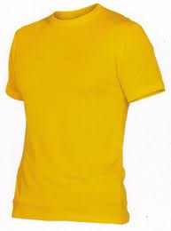
Camiseta
shirtwaist
Blouse
T-shirt

Slide 16
Fallaste

Slide 17
1 | 2 | 3 | 4 | 5 | 6 | 7 | 8 | 9 | 10 | 11 | 12 | 13 | 14 | 15 | 16 | 17

Slide 18

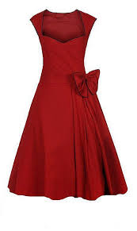
Vestido
Garb
Dress
Garment

Slide 19
Fallaste

Slide 20
1 | 2 | 3 | 4 | 5 | 6 | 7 | 8 | 9 | 10 | 11 | 12 | 13 | 14 | 15 | 16 | 17

Slide 21

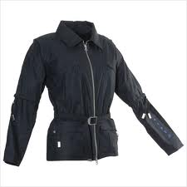
Chaqueta
Jacket
Coat
Coatee

Slide 22
Fallaste

Slide 23
1 | 2 | 3 | 4 | 5 | 6 | 7 | 8 | 9 | 10 | 11 | 12 | 13 | 14 | 15 | 16 | 17

Slide 24

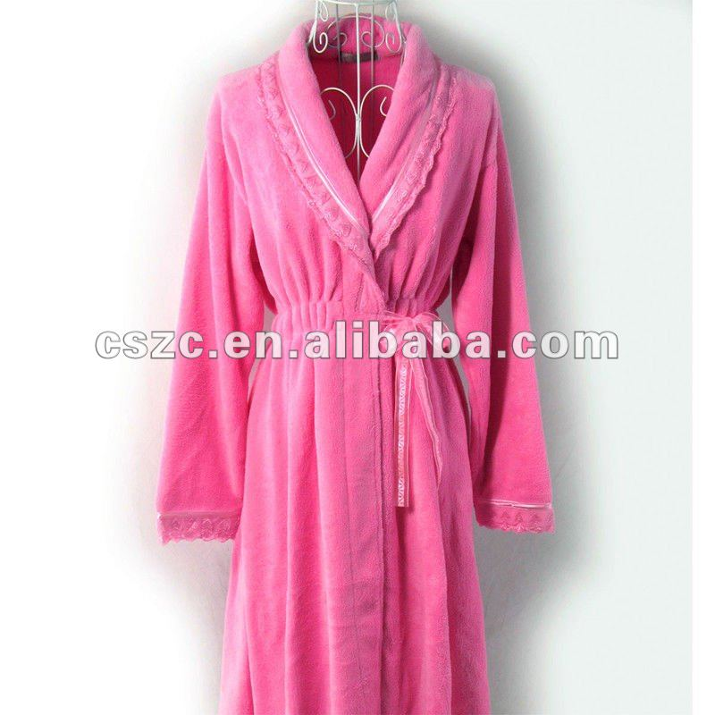
Bata
Dressing gown
Wrapper
Peignoir

Slide 25
Fallaste

Slide 26
1 | 2 | 3 | 4 | 5 | 6 | 7 | 8 | 9 | 10 | 11 | 12 | 13 | 14 | 15 | 16 | 17

Slide 27

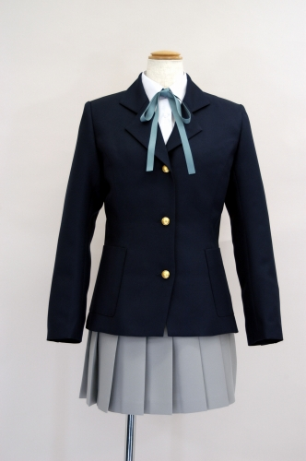
Uniforme
Regimentals
Undress
Uniform

Slide 28
Fallaste

Slide 29
1 | 2 | 3 | 4 | 5 | 6 | 7 | 8 | 9 | 10 | 11 | 12 | 13 | 14 | 15 | 16 | 17

Slide 30

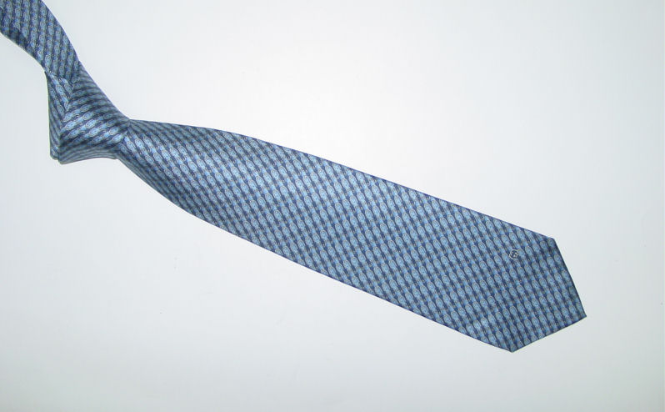
Corbata
Tie
Necktie
Ligature

Slide 31
Fallaste

Slide 32
1 | 2 | 3 | 4 | 5 | 6 | 7 | 8 | 9 | 10 | 11 | 12 | 13 | 14 | 15 | 16 | 17

Slide 33

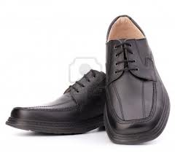
Zapato
Shoe leather
Shoe
Tennis

Slide 34
Fallaste

Slide 35
1 | 2 | 3 | 4 | 5 | 6 | 7 | 8 | 9 | 10 | 11 | 12 | 13 | 14 | 15 | 16 | 17

Slide 36

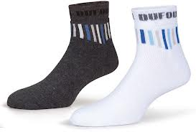
Medias
Socks
Tights
Hose

Slide 37
Fallaste

Slide 38
1 | 2 | 3 | 4 | 5 | 6 | 7 | 8 | 9 | 10 | 11 | 12 | 13 | 14 | 15 | 16 | 17

Slide 39

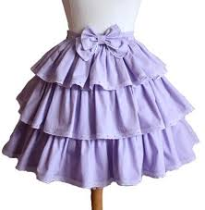
Falda
Slope
Lap
Skirt

Slide 40
Fallaste

Slide 41
1 | 2 | 3 | 4 | 5 | 6 | 7 | 8 | 9 | 10 | 11 | 12 | 13 | 14 | 15 | 16 | 17

Slide 42

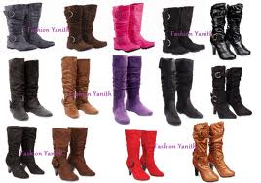
Bota
Boot
Bootee
Skate

Slide 43
Fallaste

Slide 44
1 | 2 | 3 | 4 | 5 | 6 | 7 | 8 | 9 | 10 | 11 | 12 | 13 | 14 | 15 | 16 | 17

Slide 45

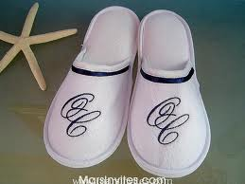
Pantufla
Mule
Slipper
Sleeper

Slide 46
Fallaste

Slide 47
1 | 2 | 3 | 4 | 5 | 6 | 7 | 8 | 9 | 10 | 11 | 12 | 13 | 14 | 15 | 16 | 17

Slide 48

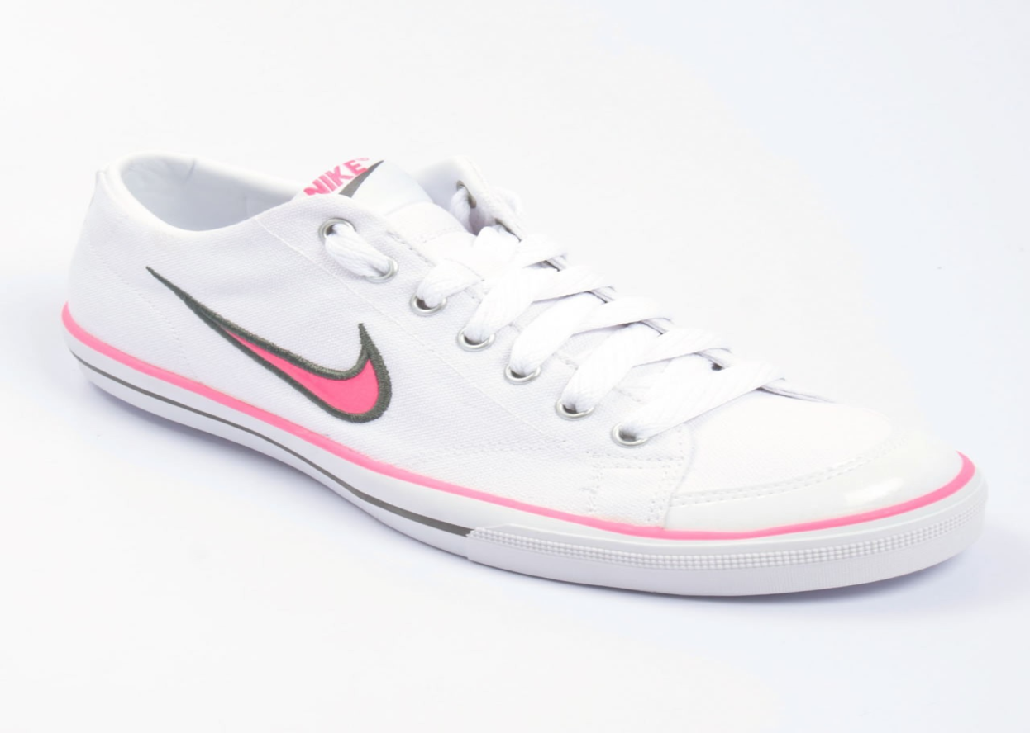
Tenis
Sneakers
Tennis shoes
Tennis

Slide 49
Fallaste

Slide 50
1 | 2 | 3 | 4 | 5 | 6 | 7 | 8 | 9 | 10 | 11 | 12 | 13 | 14 | 15 | 16 | 17

Slide 51

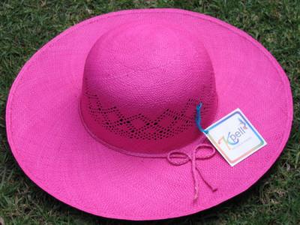
Sombrero
Cap
Hat
Bonnet

Slide 52
Fallaste

Slide 53
1 | 2 | 3 | 4 | 5 | 6 | 7 | 8 | 9 | 10 | 11 | 12 | 13 | 14 | 15 | 16 | 17

Slide 54



